Slide 1
WATER CONSUMPTION MONITORING SYSTEM
Phase 3 project

Slide 2
Water monitoring system
The Energyly Water Monitoring System gives you the power to monitor your water usage, by combining software, hardware, wireless communications and sensors, Energyly industry-leading IoT water monitoring and analytics solutions help industries and hotels to increase productivity, and compliance while enhancing safety, sustainability and service
Energyly water monitoring solutions help industries and hotels to meet the wide array of challenges from water monitoring, leakage detection, water pressure management (reducing water pressure from 70 to 50 psi could lower the total water consumption of an industry by 10 to 20%), sewer overflows and flooding to water quality, water meter data collection.
Which also enables them to more effectively manage their problems such as water conservation procedures and operations in addition to the installation of water-efficient equipment and accessories.

Slide 3
You can access your Analytics Dashboard from virtually anywhere and receive on-demand alerts via email, text through iOS and Android app or by connecting to the secure website.

Slide 4
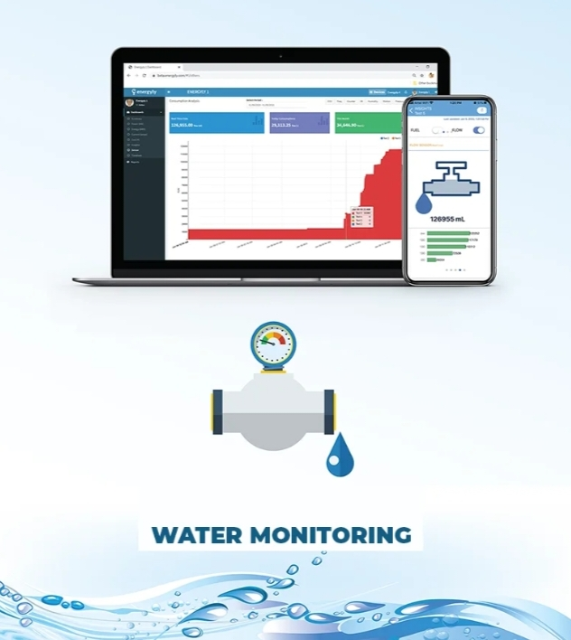
Water monitoring

Slide 5
Measure water consumption using (flow meter)
IoT Based Water Flow Meter using ESP8266 & Water Flow Sensor.
We will interface YFS201 Hall Effect Water Flow Sensor with NodeMCU ESP8266 Board.
We will display the water flow rate & Total Volume in 0.96″ OLED Display.
We will then integrate the hardware with IoT Server. For IoT Server, we will use Thingspeak App.
The water flow rate & volume data can be uploaded to Thingspeak Server & can be viewed/monitored from any part of the world.

Slide 6
Water Management System is an important part of City Management.
Water management involves supplying water according to the real requirement & without wasting Water.
Therefore it is very important to measure water flow rate and volume.
Without measuring these parameters, Water Management is almost impossible.
Also monitoring the Water Volume, Flow Rate & Water Quality remotely using Internet Connectivity has become very essential.
Therefore there is a need for Monitoring Water Management System Online.

Slide 7
There are so many Water Flow Sensors available in the market but are too expensive to use and afford.
As a result, a low-cost water flow meter is required.
So we will use YFS201 Hall Effect Water Flow Sensor with ESP8266 & design simple IoT Based Water Flow Meter.

Slide 8
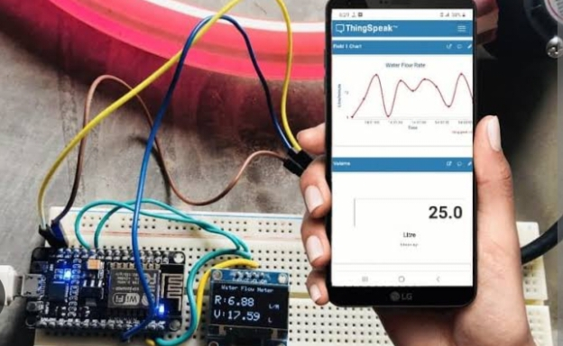
Flow meter

Slide 9
Python script iot sensor
The rapidly changing automotive industry has allowed IoT to revolutionize the automotive industry.
The internet of things (IoT) makes driving safe and efficient.
It has unleashed a range of benefits in agriculture from improving productivity to crop failure risks .
The capability IoT to diagnose a problem and avoid failure of the system is helping in preventing the breakdown scenario.

Slide 10

Python iot

Slide 11
THANK YOU

